Slide 1
AERIAL OBJECT DETECTION AND TRACKING
ARNAB MANDAL
ARTIFICIAL INTELLIGENCE AND RESEARCH INTERN

Slide 2
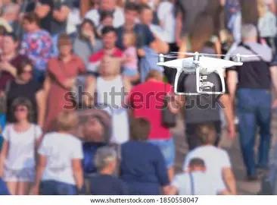
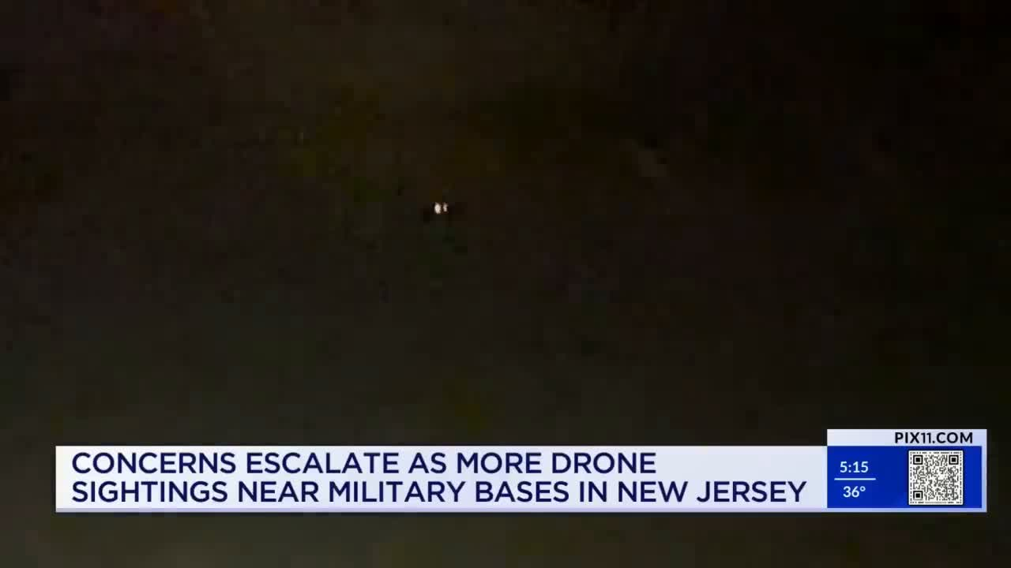
Problem Statement
The objective was to:
Analyse videography and imagery of aerial objects
Identify and Flag Drones and UAVs

Slide 3
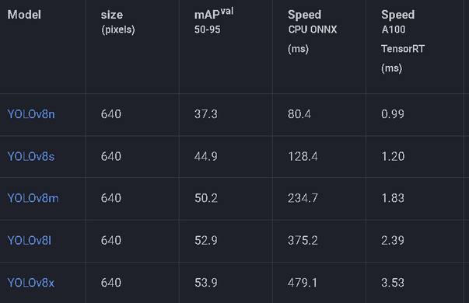
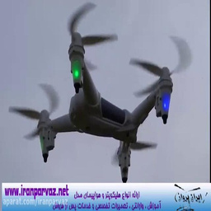
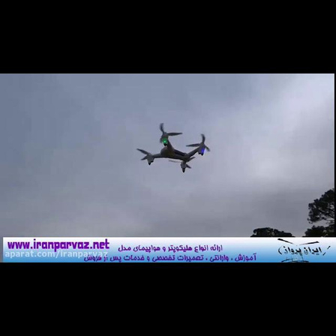
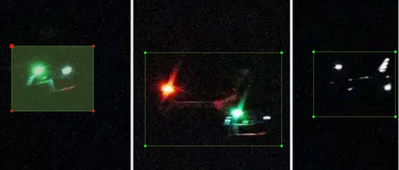
Provided Solution
Custom Dataset
Model
Training Dataset
Scraped images of drones and UCAVs using bing and selenium
Images were selected for instances of drone sightings in ongoing wars, crowded environments and difficult to recognise surroundings
Dataset was manually created with labels using labelImg
Utilised YOLOv8 object detection model
Provides object detection and tracking capabilities
Trained model on roboflow drones and UAVs computer vision dataset
Provides 9.3k clear and usable images of drones and other UAVs
The model was trained for 5 epochs on the training dataset, and 10 epochs on the custom dataset.

Slide 4
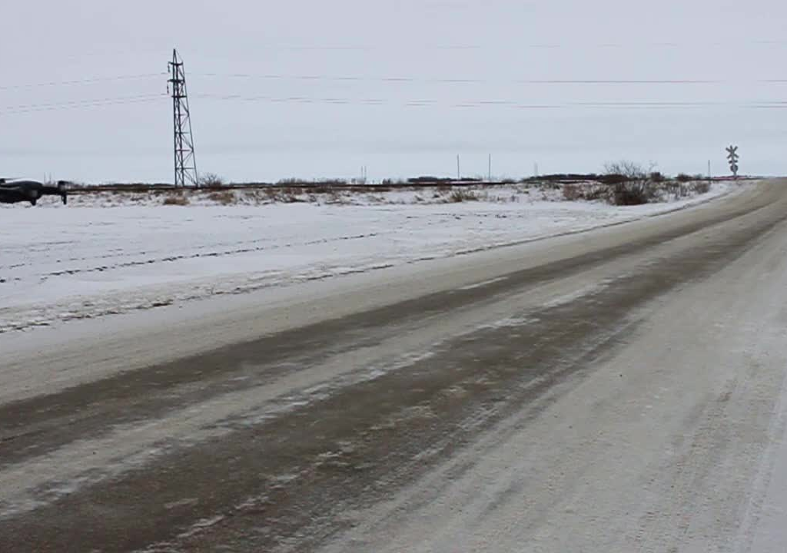
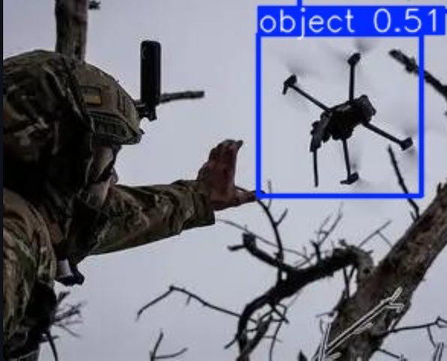
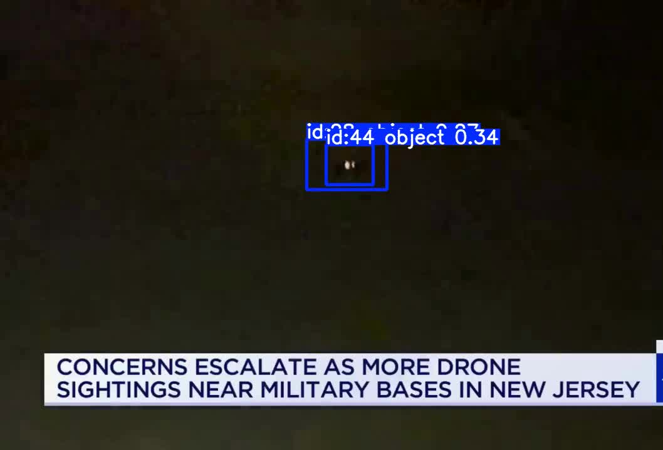
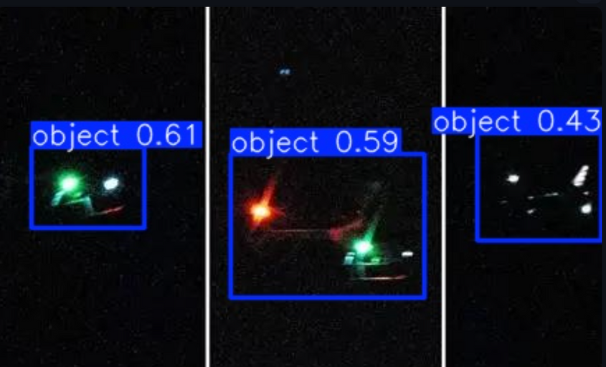
Results and Analysis
The model scored 90%+ on all accuracy tests for the training dataset.
The model scored around 70% accuracy while finetuning on the custom dataset.
The images and videos to be analyzed can be entered through the frontend and then observed on it as well
Future expansion can include creating a more thorough dataset catered to real usage.

